Slide 1


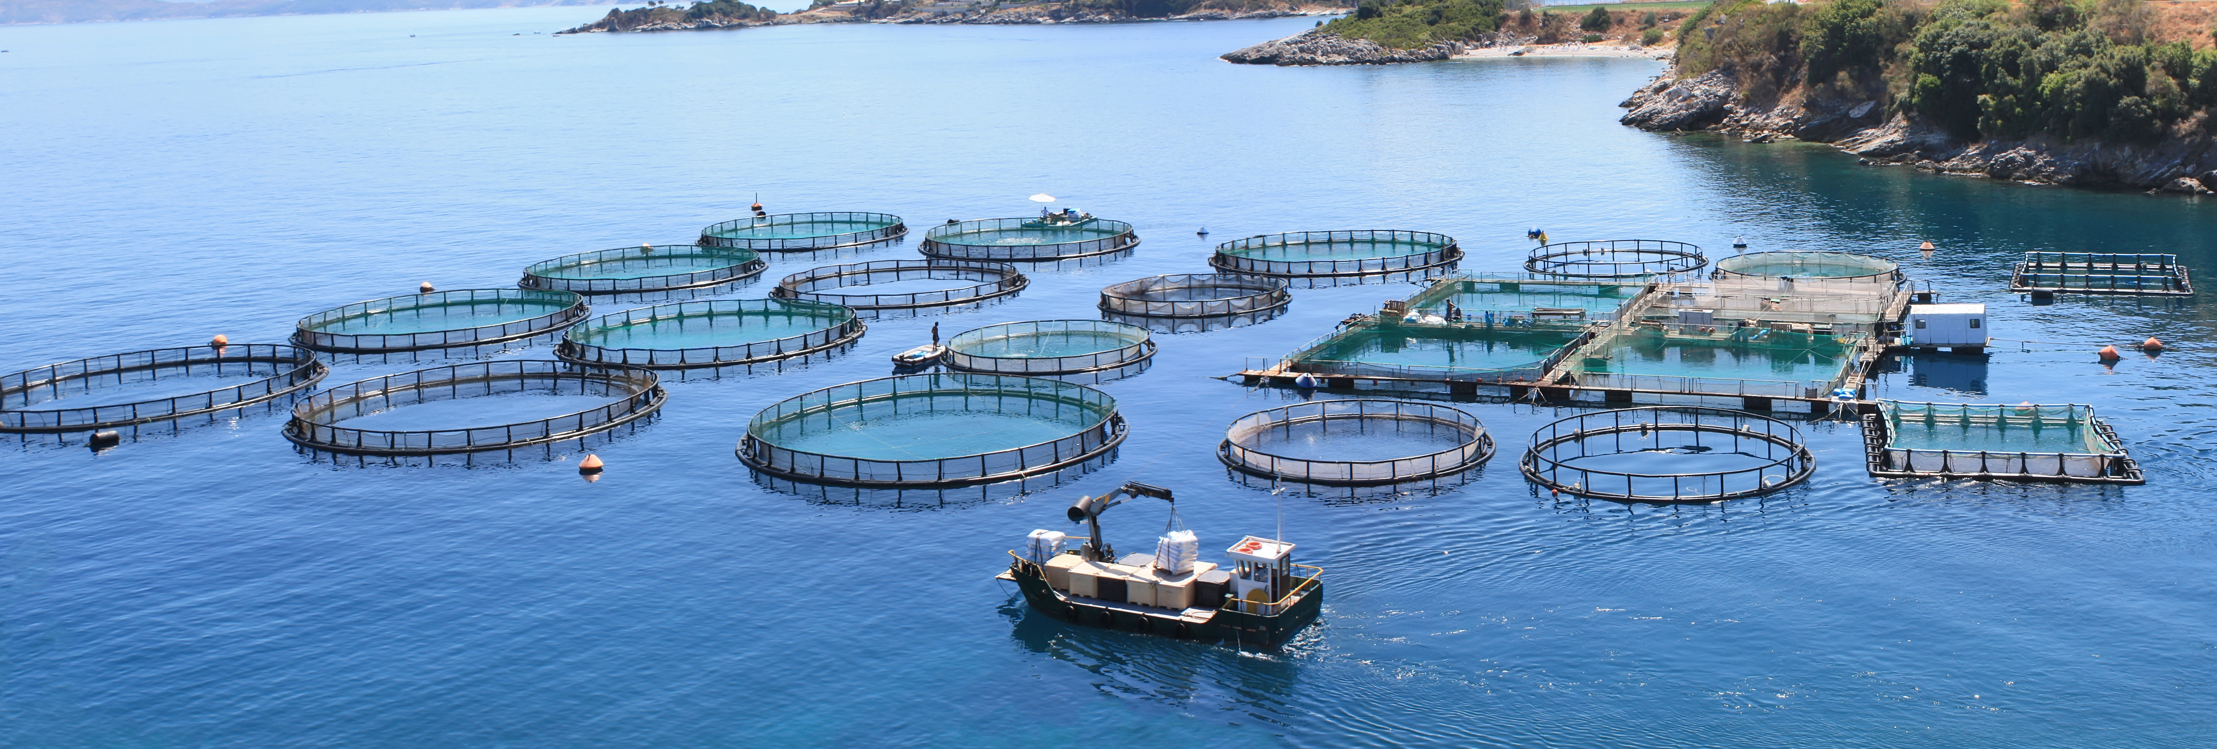





Preventing e-waste from polluting MED water by
turning waste into a resource.
OUR PROJECT
eWAsTER aims to promote local and regional policies for better e-waste management, to reduce e-waste environmental damage in the selected areas, while promoting new innovative eco-business models based on the conversion of the currently lineal electrical and electronic sector into a sustainable circular model.
eWAsTER’s 11 partners aim to approve 10 new Action Plans for e-waste management in order to help unify the transnational MED area’s waste management criteria, through join planning and coordinated business promotion.
Total budget
Project duration
Interreg Funds
€ 2 046 650
33 months
€ 1 637 320
PROJECT PARTNERS
Parque do Alentejo de Ciência e Tecnologia • Consejería de Sostenibilidad, Medio Ambiente y Economía Azul • Δήμος Ρεθύμνης • Regione Marche • Okoljsko Raziskovalni Zavod • Općina Neum • Асоциация на Българските Черноморски Общини • Unione Pian del Bruscolo • Consorcio Provincial de RSU de Málaga • Udruzenje za poduzetnistvo i posao LiNK • Δήμος Αραδίππου
Visit our website
www.interreg-euro-med.eu
Follow us on our social media

